Slide 1
EFFICIENT STEGANOGRAPHIC TECHNIQUE USING SECURED DATA HIDING WITH BIT STREAM DATA TRANSFER
BY SUJITHA.S
NANDHINI.V
KALPANA.P
GUIDE : DEVIPRIYA .S[AP/IT]

Slide 2
PROBLEM STATEMENT
In current scenarios have propose single image with data hiding , it doesn’t provide satisfactory security . So efficient steganography technique using secured data hiding with bit stream data transfer will be propose with dual image data hiding to improve the security.

Slide 3
ABSTRACT
Efficient steganography technique with dual image , that one is cover image and other one is spatial embedding image by incorporating the statistics of both the spatial and DCT domains. The spatial statistics of the decompressed JPEG images , data is hide in embed space with the distortion measures of some efficient steganographic schemes in the spatial domain.

Slide 4
LITERATURE SURVEY
Adaptive steganography, hypothesis testing theory
proposed by Jessica Fridri , Remi – Content Adaptive
Steganography by minimizing statistical detectability in 2017.
Adaptive steganography , embedding probabilities,
Re embedding propose by Weixuan Tang ,Haodong li –
Adaptive steganalaysis based on embedding
probabilities of pixels in 2015.
Color channel correlation, modification direction,
Steganalysis proposed by Weixuan Tang, Bin Li – Clustering
Steganography modification direction for color components in
2016.

Slide 5
NAME OF THE PAPER | METHOD | TOOLS /TECHNOLOGY | ADVANTAGES | DISADVANTAGES
Content –Adaptive Steganography by minimizing statistical detect ability | Adaptive steganography, Hypothesis testing theory | It uses distortion function & LSB matching | Most powerful detection of content adaptive LSB matching | complex enough to capture non-stationary character of natural images
Adaptive steganalaysis based on embedding probabilities of pixels | Adaptive steganography , embedding probabilities, Re embedding | Non-Adaptive technology & S-UNIWARD(distortion function) | Highly concentrated on the textual regions within an image | Such regions are difficult to model for steganalysis
Clustering Steganography modification direction for color components | Color channel correlation, modification direction, steganalysis | CMD-C (Clustering modification directions for color components) | Increase empirical security | It is unclear to preserving the channel correlation

Slide 6
REQUIREMENT ANALYSIS FOR EACH MODULE
MODULE 1 : Key image , cluster division , and random permutation algorithm.
MODULE 2: Original image use to hided the text using LSB algorithm.
MODULE 3: Combined both images using random permutation algorithm , encrypted the file using MD5 algorithm and compressed the image using Image lossyless compression algorithm.
MODULE 4: Decompressed the file using reverse of Image lossyless compression and decrypted the file using reverse of MD5 algorithm.
MODULE 5: Extracted the image and the hided text.
FRONT END: .Net
BACK END: C#

Slide 7
FRONT END WITH ERROR TOLERANCE
Microsoft .NET itself an error tolerance.
Conversion from a low-level assembler-style language, called Intermediate Language (IL), into code native to the platform being executed on.
Memory management, notably including garbage collection.
Checking and enforcing security restrictions on the running code.
Loading and executing programs, with version control and other such features.

Slide 8
TEST PLANNING
Testing is a process of checking whether the developed system is working according to the original objectives and requirements. Testing is a set of activities that can be planned in advance and conducted systematically. Testing is vital to the success of the system. System testing makes a logical assumption that if all the parts of the system are correct, the global will be successfully achieved.
Following this step a variety of tests are conducted.
Unit testing
Integration testing
Validation testing

Slide 9
FUNCTIONAL TESTING:
Test case no | Description | Actual Result | Expected result | Result
1. | Test for all cache responses. | All cache responses should be in the approximate value around 28.9ms. | All cache responses should be in the approximate value around 28.9ms. | Pass

Slide 10
NON-FUNCTIONAL TESTING
This testing used to check that an application will work in the operational environment.
Non-Functional Testing includes
Load testing
Performance testing
Reliability testing

Slide 11
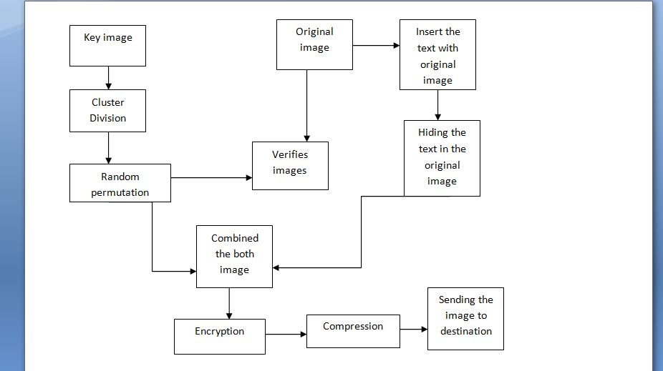
ARCHITECTURE DIAGRAM ENCRYPTION OR SENDER SIDE

Slide 12
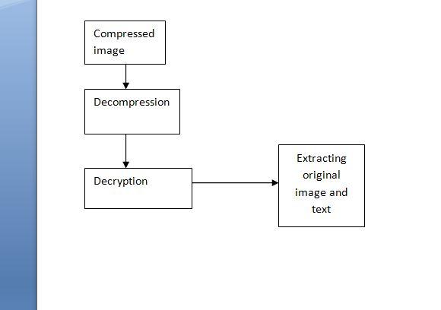
DECRYPTION OR RECEIVER SIDE

Slide 13
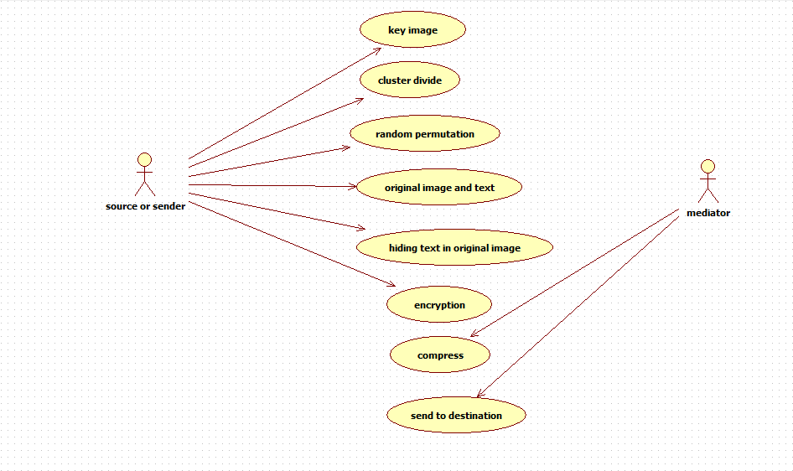
USE CASE DIAGRAM ENCRYPTION OR SENDER SIDE

Slide 14
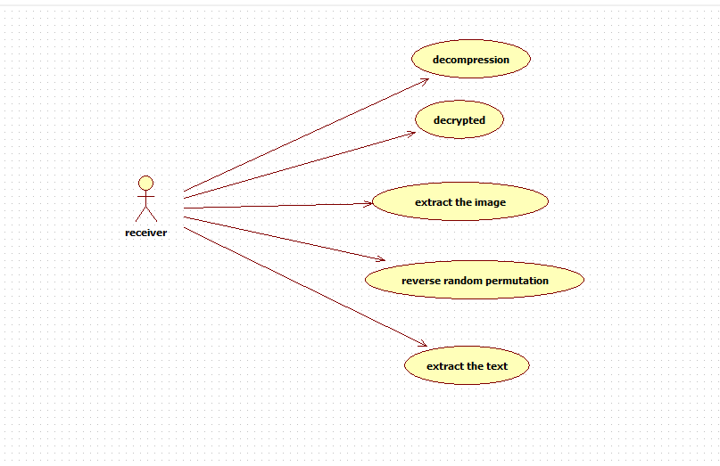
DECRYPTION OR RECEIVER SIDE

Slide 15
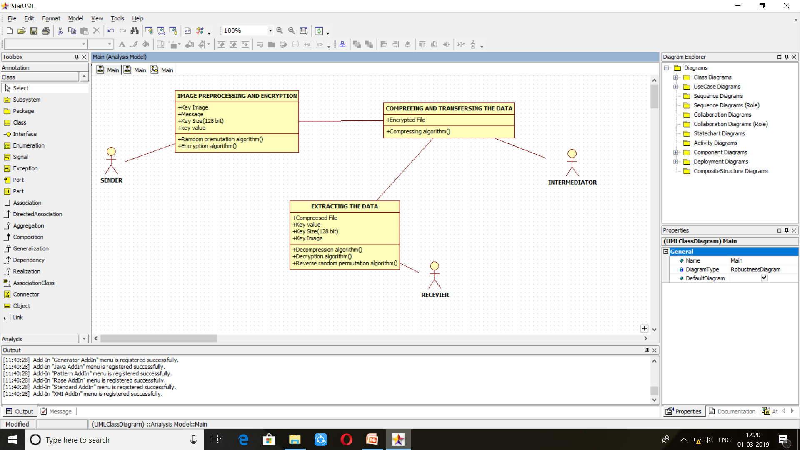
CLASS DIAGRAM

Slide 16

ER DIAGRAM

Slide 17
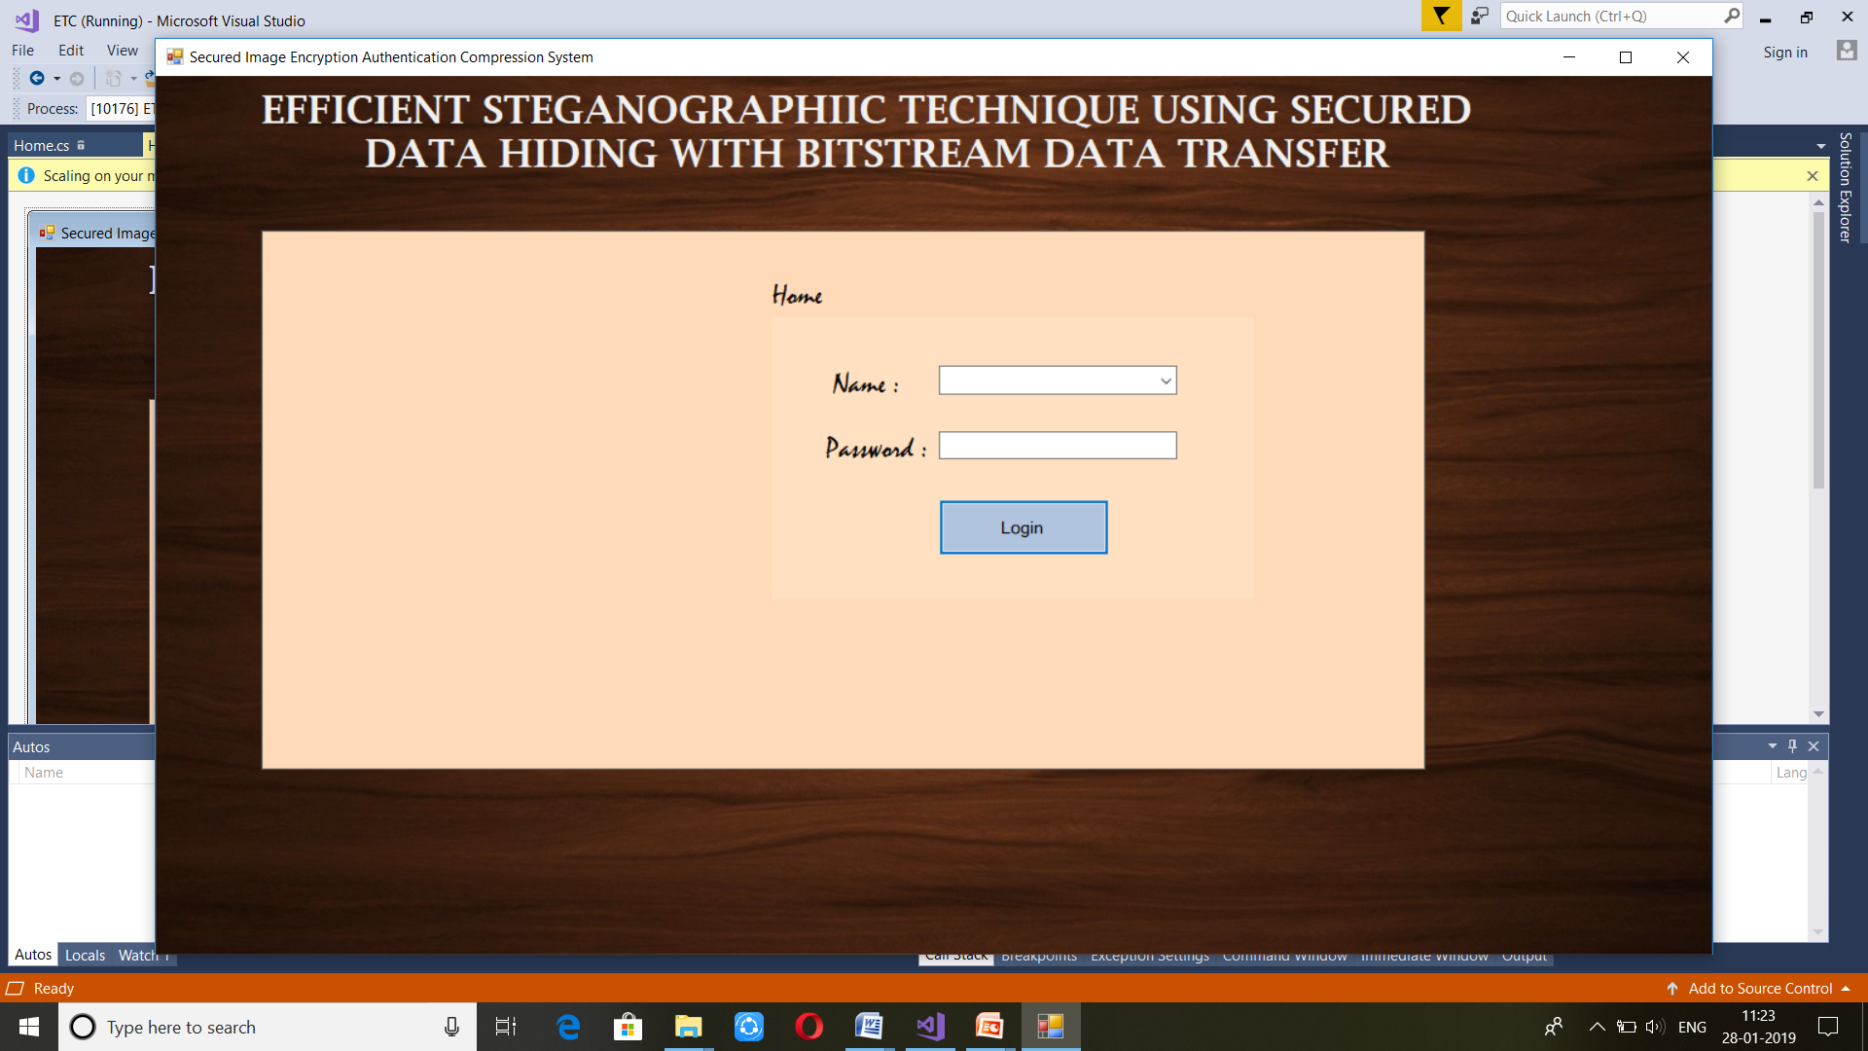
MODULES(LOG IN)

Slide 18
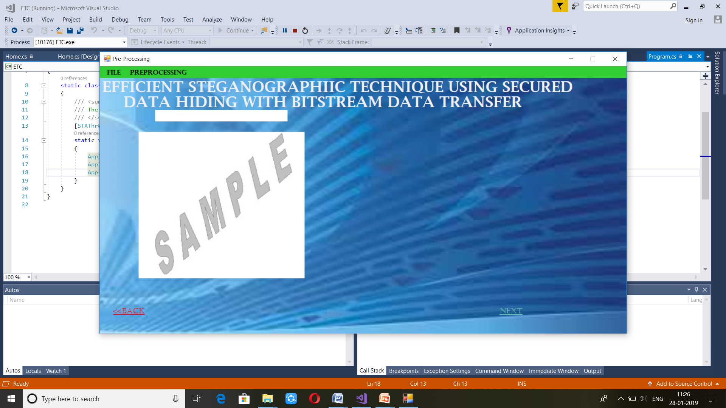
PRE-PROCESSING

Slide 19
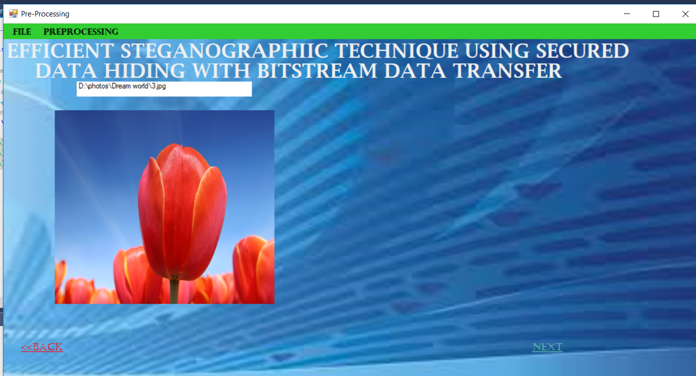
IMPORTING IMAGE

Slide 20
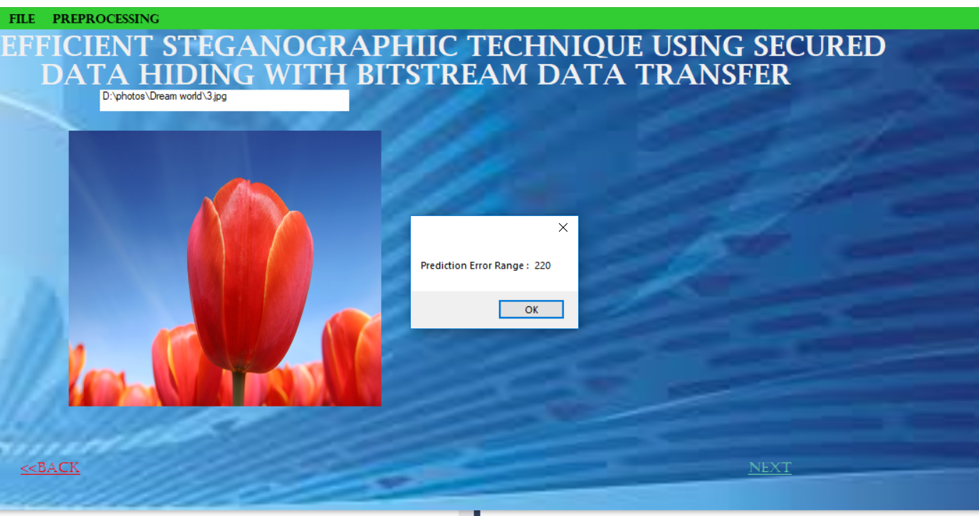
PREDICTION OF ERROR

Slide 21
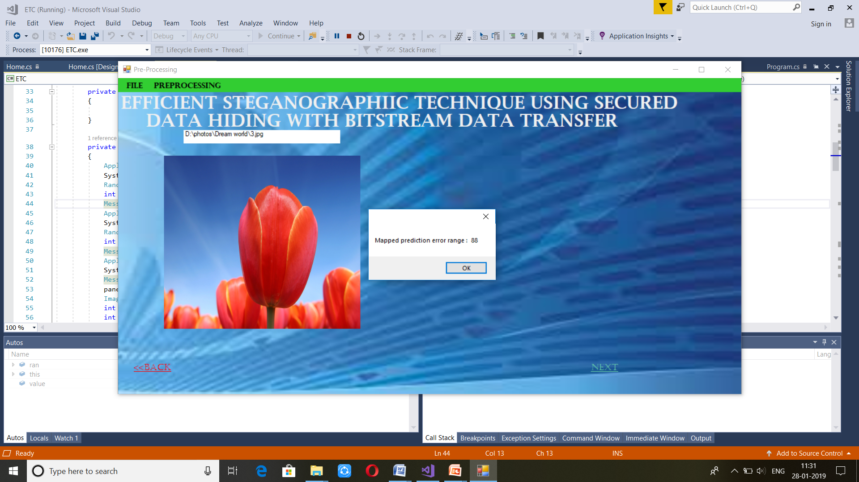
MAPPING OF PREDICTION ERROR

Slide 22
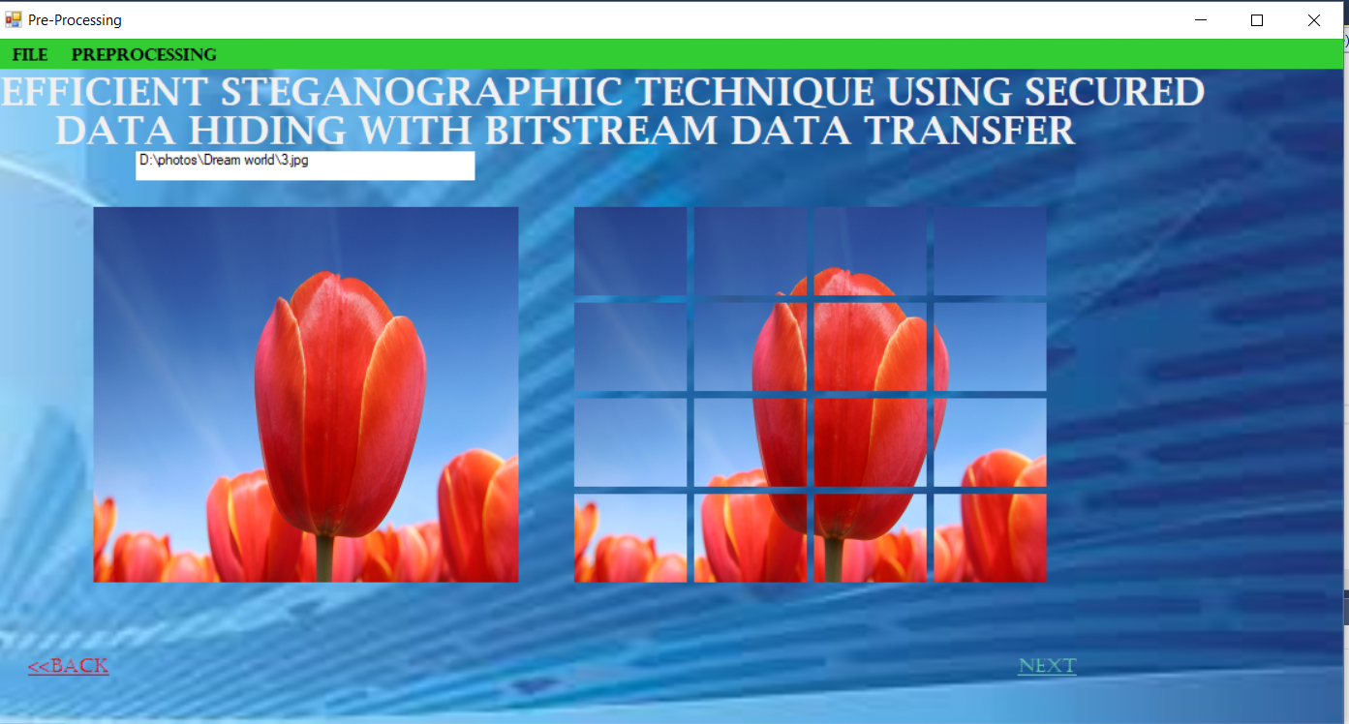
CLUSTER DIVISION

Slide 23
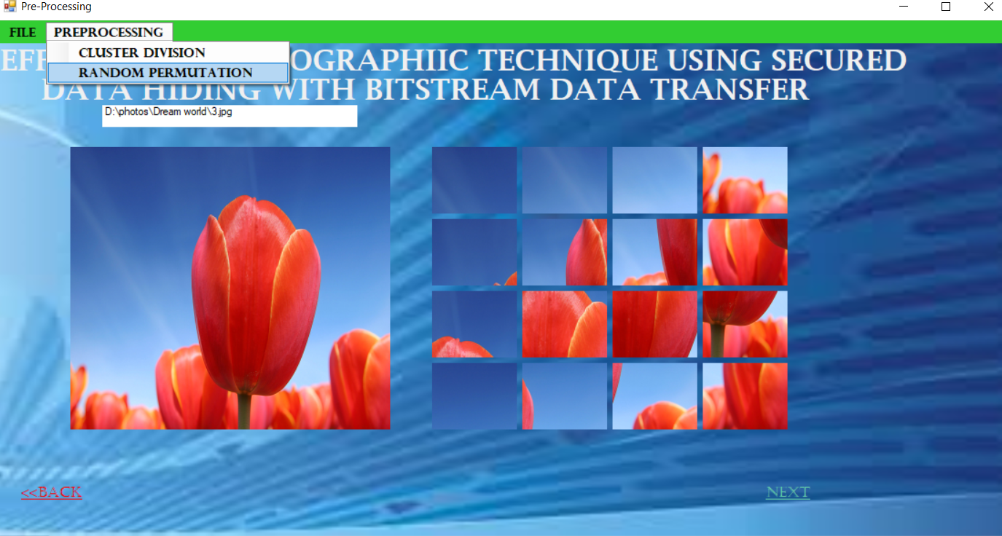
RANDOM PERMUTATION

Slide 24
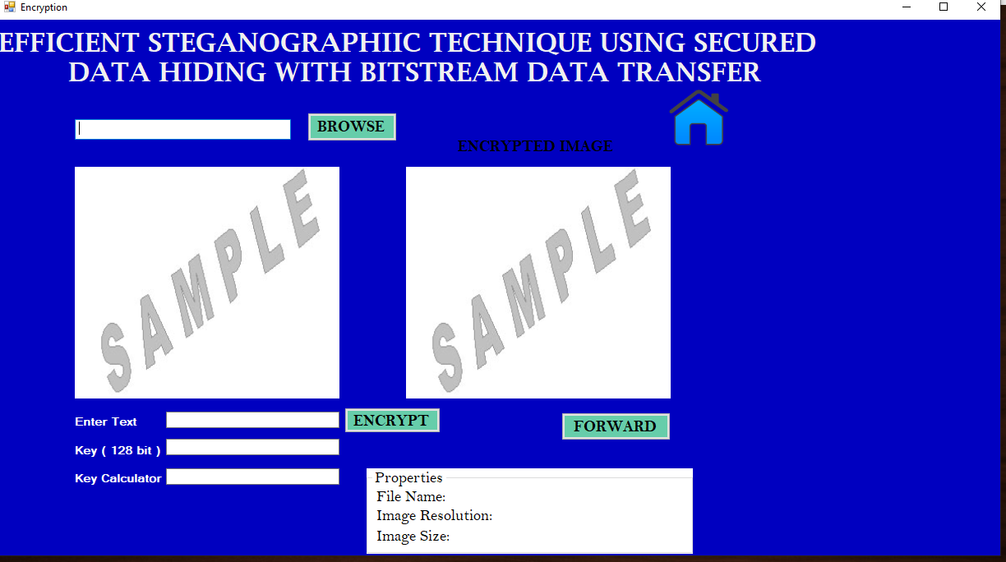
ENCRYPTION

Slide 25
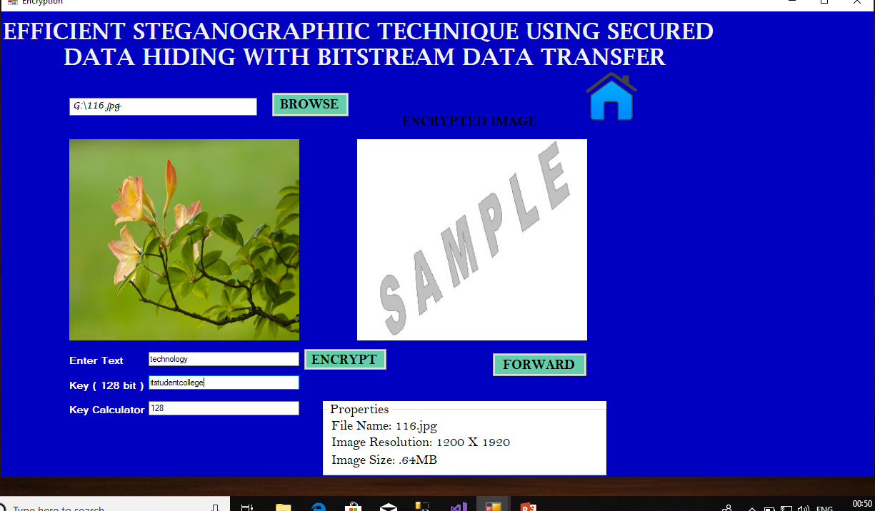
CHOOSE IMAGE FOR ADDING TEXT

Slide 26
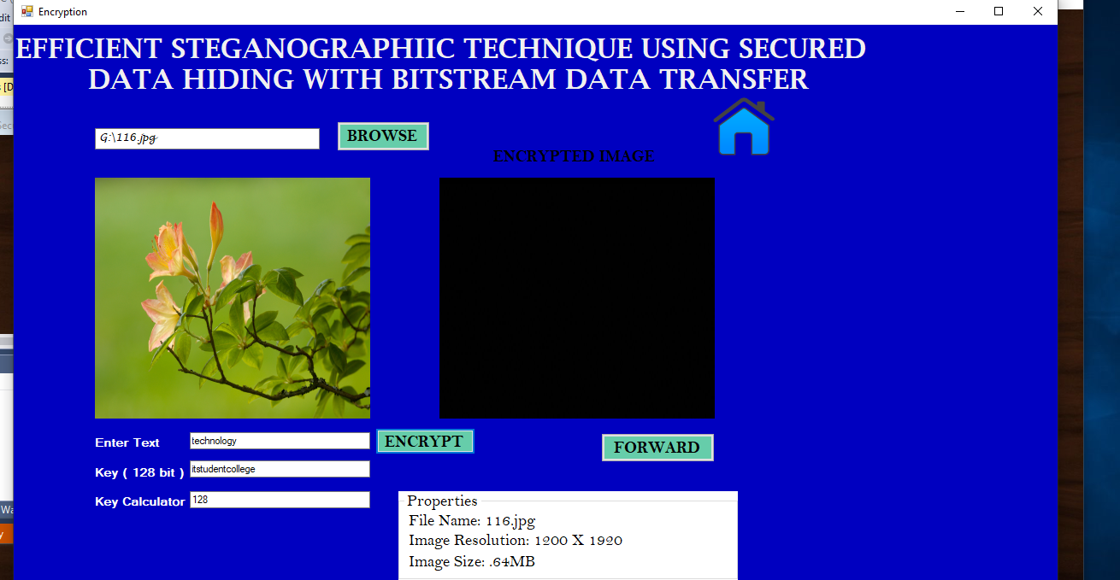
ENCRYPTED WITH TEXT

Slide 27
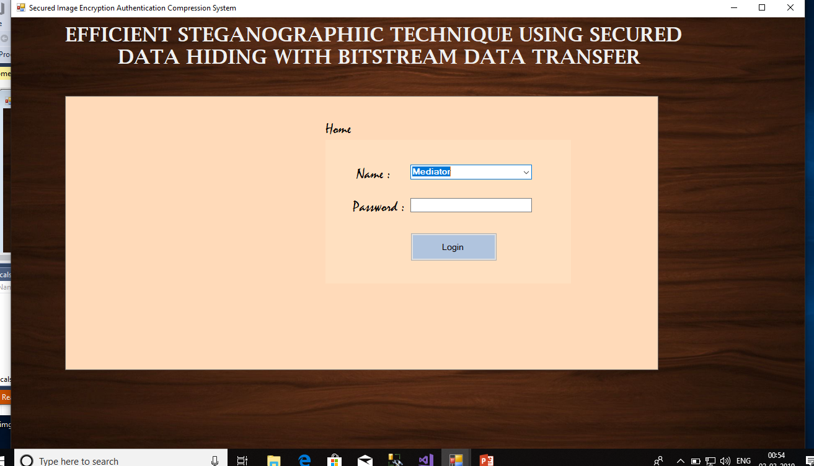
LOGIN FOR MEDIATOR

Slide 28
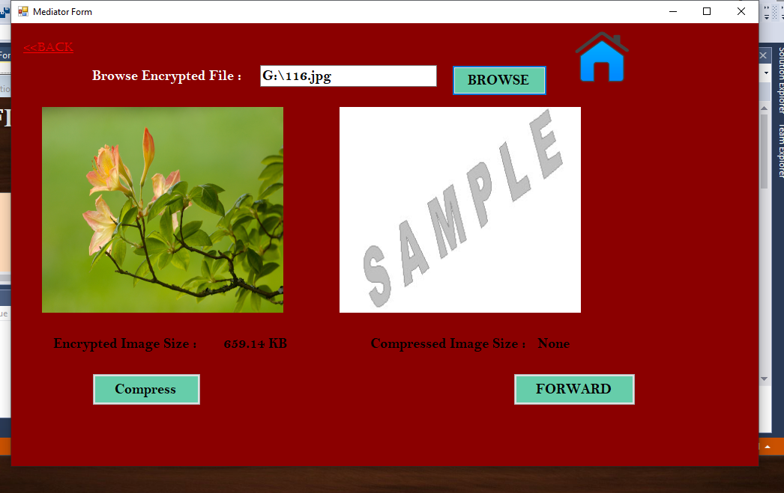
CHOOSE ENCRYPTION IMAGE

Slide 29
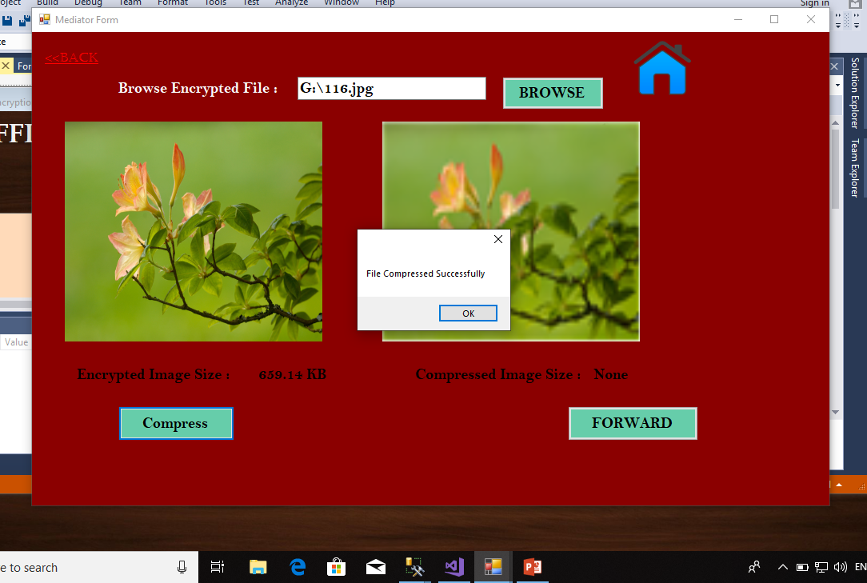
IMAGE COMPRESSION

Slide 30
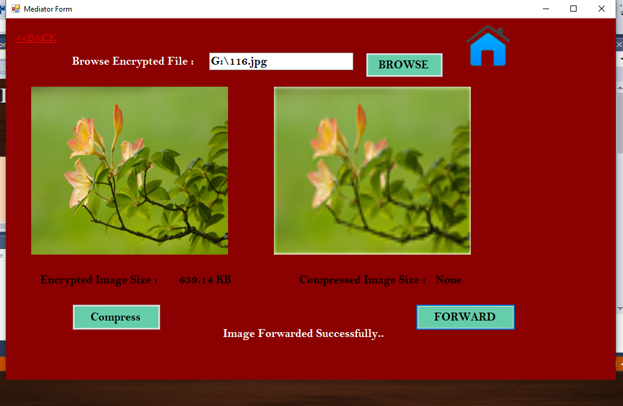
IMAGE IS COMPRESSED

Slide 31
TABLES-FIELD DETAILS
Encryption – Image id , Image name, Path, Key.
Decryption - Image id , Image name , Image path , User id
Admin – User name , Password , Role.
Compression - Compression name, Image name, User id, Compression size , Compression path.
Decompression - Decompression name , Image name , User id, Decompression size , Decompression path.

Slide 32
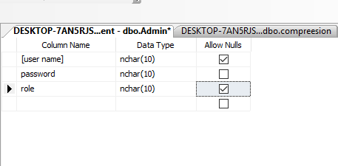
TABLES: 1)ADMIN

Slide 33
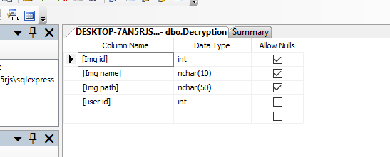
2) ENCRYPTION

Slide 34
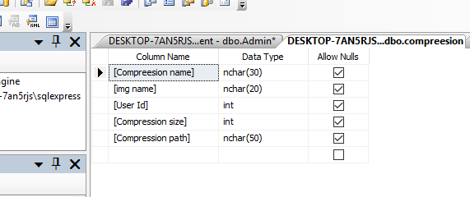
3)COMPRESSION

Slide 35
4)DECRYPTION

Slide 36
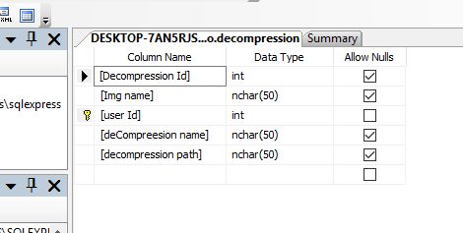
5)DECOMPRESSION

Slide 37
CONCLUSION
To improve the security performance of JPEG steganography in the spatial domain, dual image steganography with data hiding should be compressed and transfer.

Slide 38
ANY QUERIES

Slide 39
Referrence
sedighi2016.pdf
tang2015.pdf
tang2016.pdf

Slide 40
THANK YOU

